Slide 2
Azure Active Directory is not Active Directory
Sam Cogan
Solution Architect, Willis Towers Watson & Azure MVP

Slide 3




About Me
Sam Cogan
Solution Architect – Willis Towers Watson
Microsoft Azure MVP
samcogan.com
@samcogan
sam-cogan

Slide 4


Azure Active Directory is not Active Directory
Azure Active Directory

Slide 5
Azure AD Features
Cloud Based Identity Store for Users and Groups
Application Store
Modern Authentication Protocols – Oauth, SAML, Open ID
Identity Protection
Collaboration

Slide 6
Azure AD Doesn’t Support
Domain Join and Machine Management
Group Policy
LDAP, NTLM, Kerberos
LDAP
OUs, Forests, Trusts

Slide 7
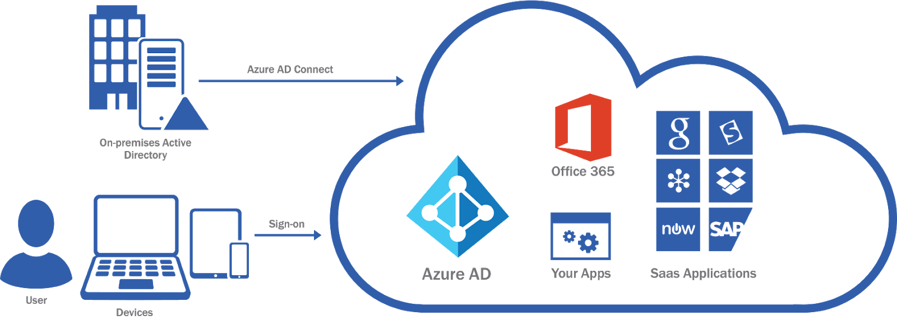
Cloud & Hybrid

Slide 8
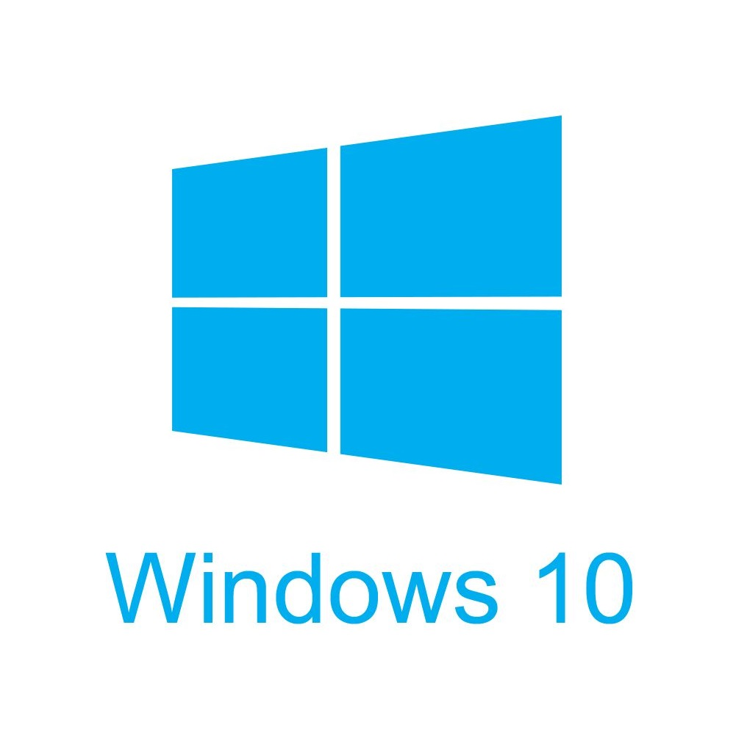
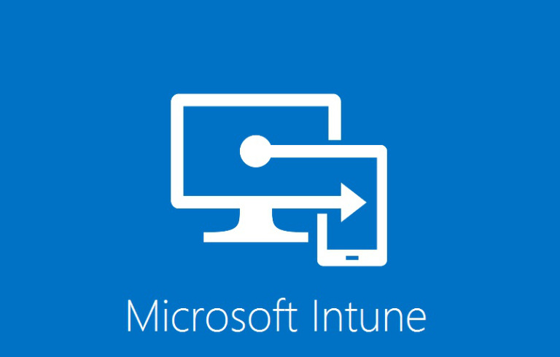
Cloud Native Solutions

Slide 9
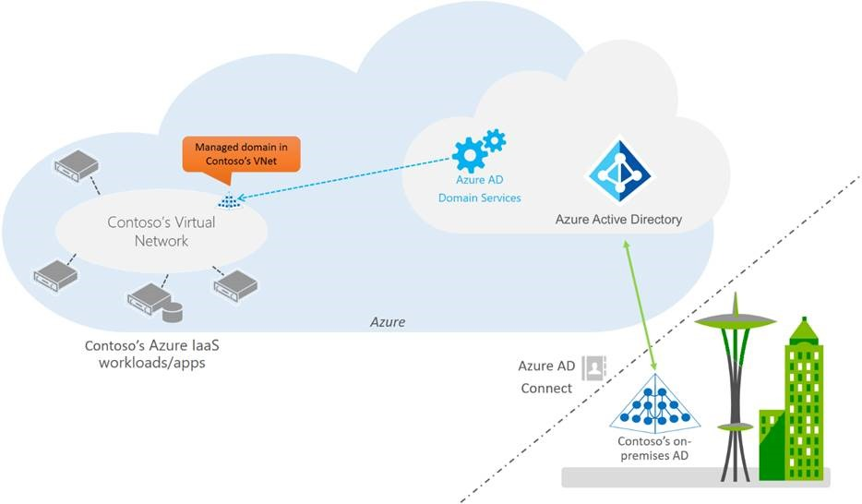
Azure AD Domain Services

Slide 10
IaaS Domain Controllers

Slide 11
About Me
Sam Cogan
Solution Architect – Willis Towers Watson
Microsoft Azure MVP
samcogan.com
@samcogan
sam-cogan

